Slide 1
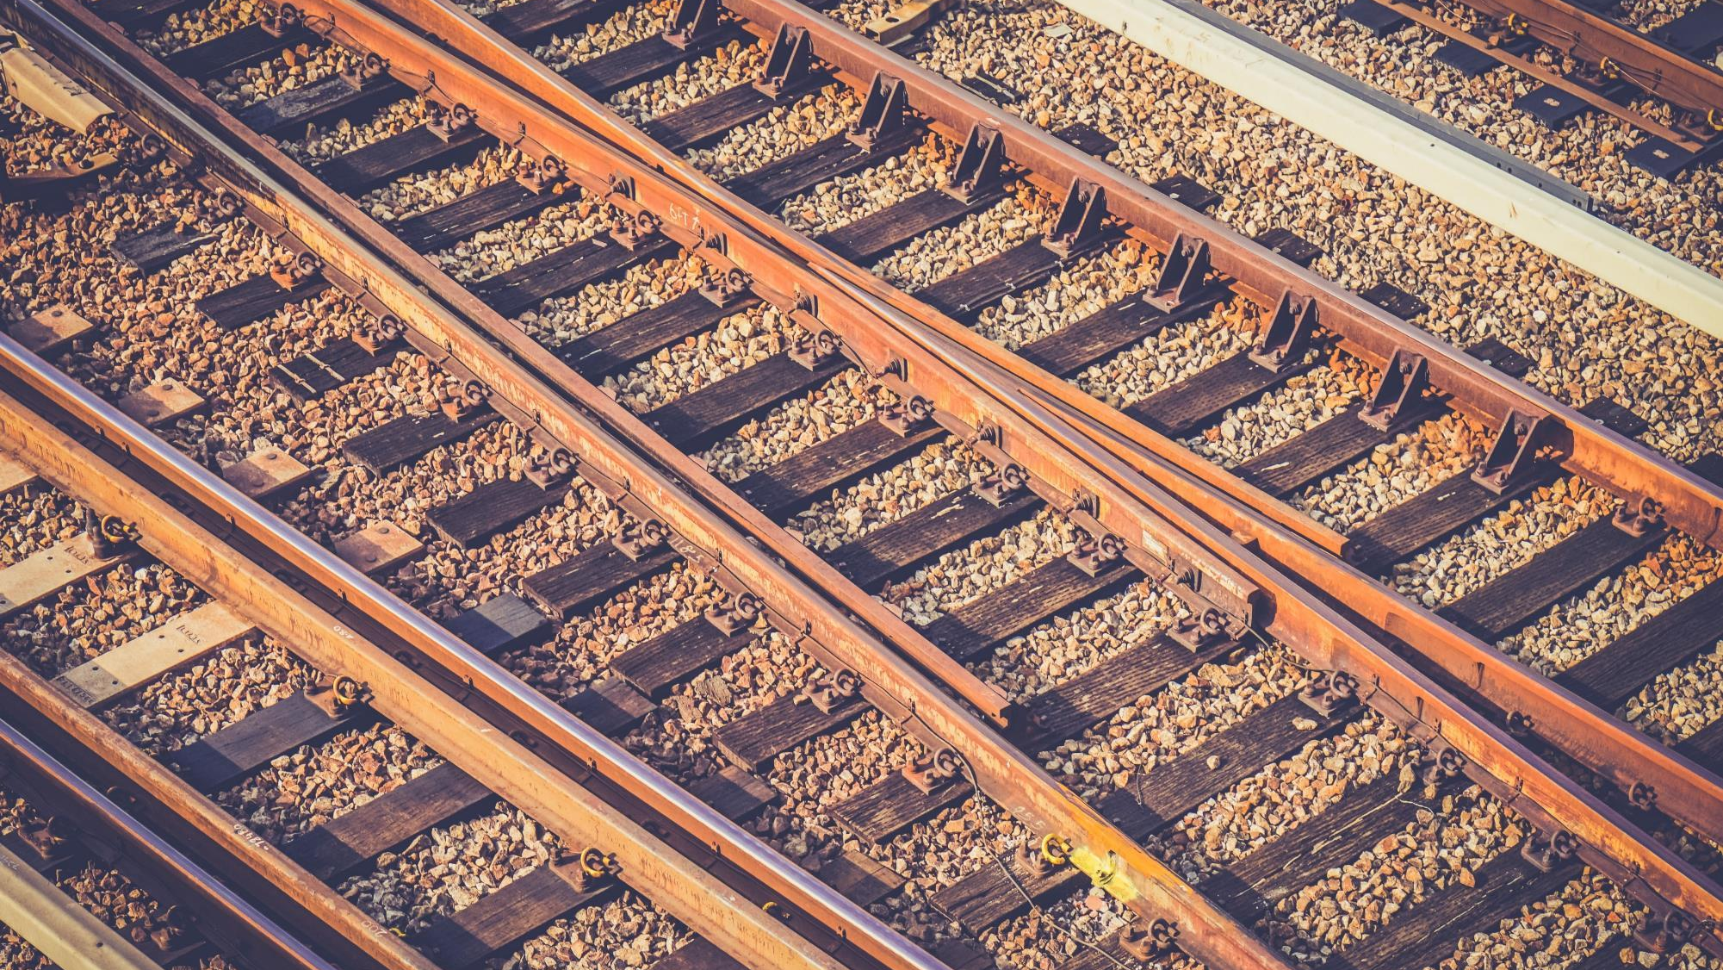
SMART RAIL
Smart India Hackathon - 2018
Black Caps
Notes:
To use this title animation slide with a new image simply 1) move the top semi-transparent shape to the side, 2) delete placeholder image, 3) click on the picture icon to add a new picture, 4) Move semi-transparent shape back to original position, 5) Update text on slide.

Slide 2
SMART INDIA WANTS A SMART RAIL
WHY
?
Railway has a lot to offer, but still struggling to deliver its full potential.
Traditional and Outdated Approach
The Huge Information Gap
Lack of an Integrated Service Platform

Slide 3
OUR AIM
Digitalization of the Railway Services
Bridge the information gap
WE WANT TO POWER THE ENGINE OF INDIA
Virtual Guide of the passengers
Self-evolving Community Framework

Slide 4
HOW
?
Before you board your train .
While you are on your train.
After you get off your train .

Slide 5
The Beginning
Before your board your train
“Get”
Plan your journey
“Set”
Visit Railway Station
“Go”
Board your Train

Slide 6
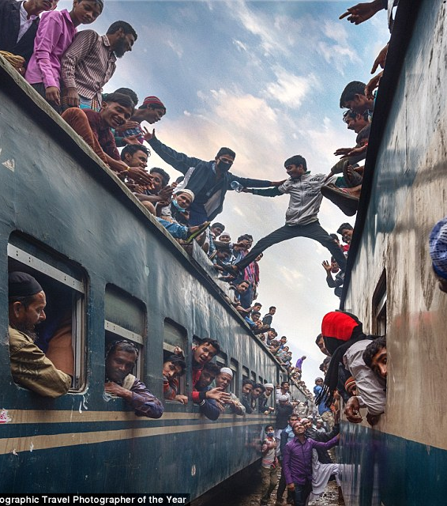
GET
Plan your journey
1. Learn from other’s experience.
2. Use your past preferences.
3. Predicting Algorithms.
4. *Current Trend.

Slide 7
SET
Visit Railway Station
1. Digital Enquiry Window
2. Digital Announcements
3. *Station Mapping
4. Digital Safai

Slide 8
GO
Board your Train
1. *Digital Coolie Booking.
2. Navigate to your seat.
3. Get the doors open.
4. *SOS.

Slide 9
3 C’s
While you are on your train
“Comfort”
House on the move.
“Communicate”
Get curious.
“Care”
Railway at its best.

Slide 10
The Conclusion
After you get off your train
“Chill”
Feel at Home.
“Ride”
Get your Taxi.
“Bye”
…

Slide 11

ALONE WE CAN DO SO LITTLE,
TOGETHER WE CAN DO SO MUCH.
—HELEN KELLER

Slide 12
Family First
Together we can grow
“Community”
Share your experiences
“Forum”
Help others out
“Travel Diary”
Create Memories

Slide 13
SMART AND PROFESSIONAL
STRENGTH
One app for everything that’s Railway.
Scalable
Integrable
Future proof

Slide 14
STEP TOWARDS PERFECTION
OPPORTUNITIES
Railway has a lot to offer, but still struggling to deliver its full potential.
Traditional and Outdated Approach
The Huge Information Gap
Lack of an Integrated Service Platform

Slide 15
“THE INDIAN RAILWAYS WILL BECOME THE GROWTH ENGINE OF NATION’S ‘VIKASH YATRA’”.
—NARENDRA MODI, PRIME MINISTER OF INDIA

Slide 16
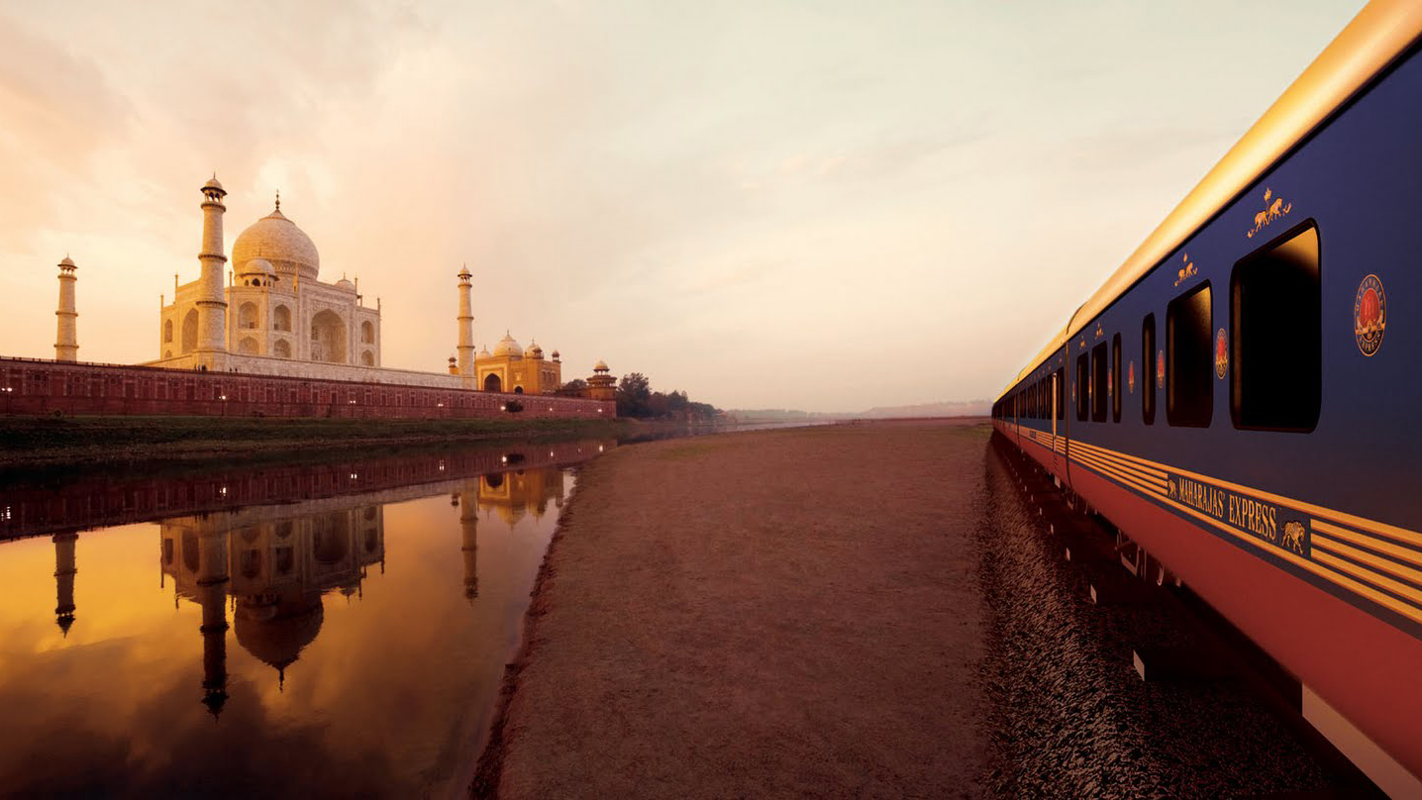
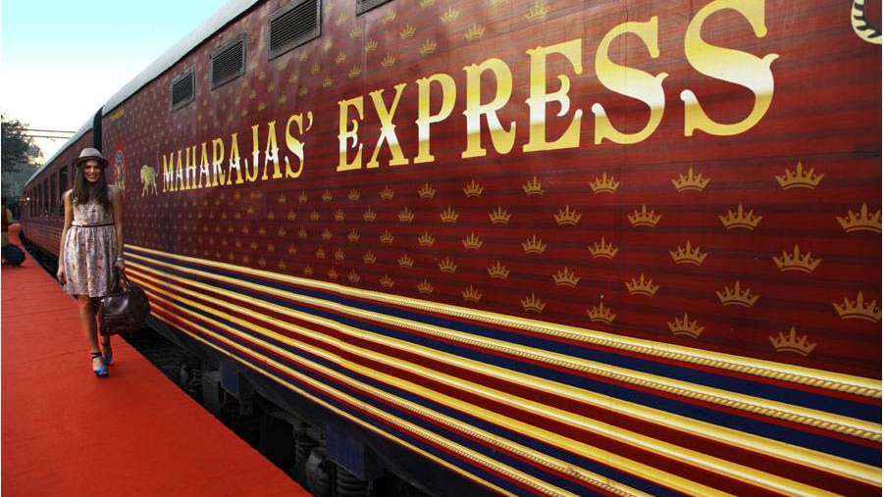
HAVE AN AWESOME DAY!
THANK YOU

Slide 17
VISUALS ADD A COMPONENT TO STORYTELLING THAT TEXT CANNOT | SPEED.
FUTURE
Images are another element that can drive your point home even more

Slide 18
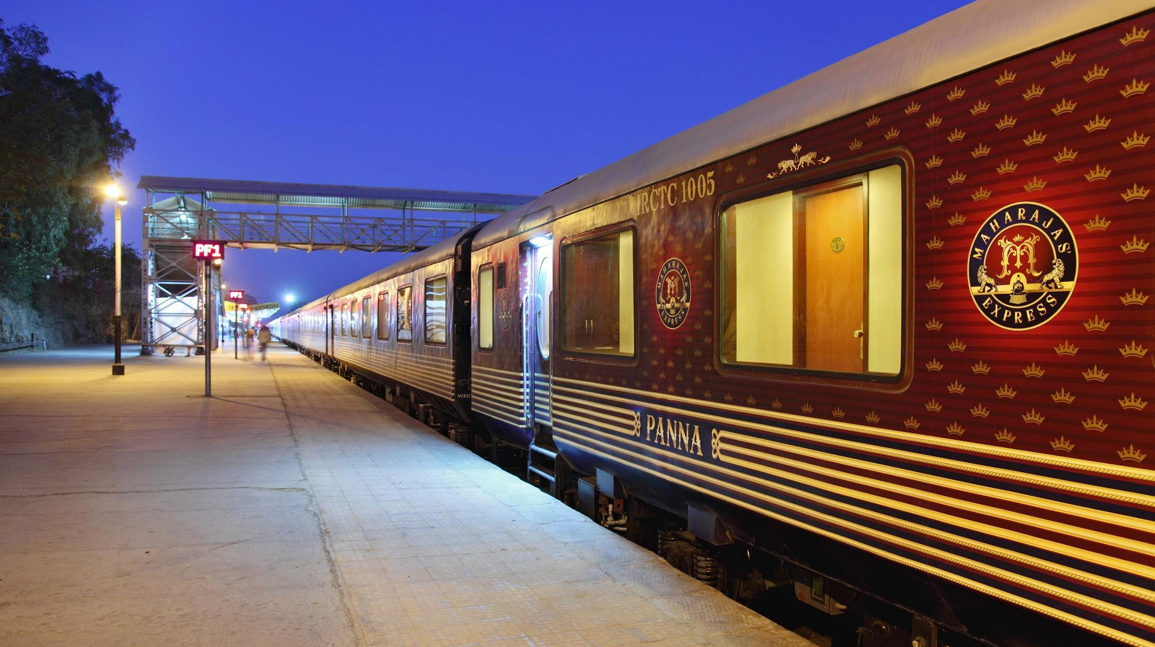
3
Images are a great tool for showing context
SUPPORT
We perceive the world through more than our eyes and ears; we smell, we touch, and we taste.
Put your audience in that place and provide them a point of reference; the imagination will do the rest.
Notes:
Tip:
When using complex image as full-bleed background add a transparency (70%-90%) fill layer to give contrast to text.

